Slide 1
Food Label for packaged food
1. Nutrition Facts table
2. List of ingredients
3. Nutrition claim

Slide 2
Food Labels
Make healthy choices
1. Help limiting: saturated fat, trans fat, sugar, salt(sodium) and cholesterol.
2.Find food higher: good fat,vitamins, minerals(Fe, Ca), fiber and protein.
3.Make healthier choices: compare different foods.
4. Read ingredients: what is inside the package.

Slide 3
Nutritional facts
1. Serving size; amount used to calculate nutrition number.
2.Calories: carbohydrates, protein and /or fat.
3.%DV: a guide to help you make informed choices. Applies to all nutrients.
5% or less is little 15% or more is a lot
4. Information on the 13 core nutrients: Fat(saturated, tran, cholesterol), sodium, carbohydrate, fiber, sugar, protein,( Va, Vc), Ca, Fe

Slide 4
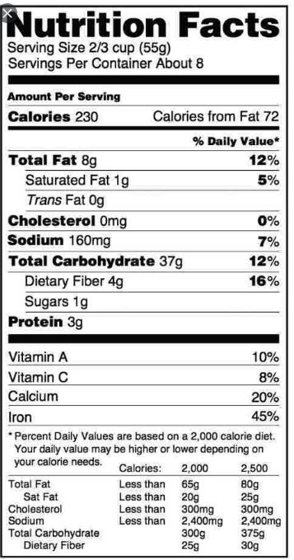

Slide 5
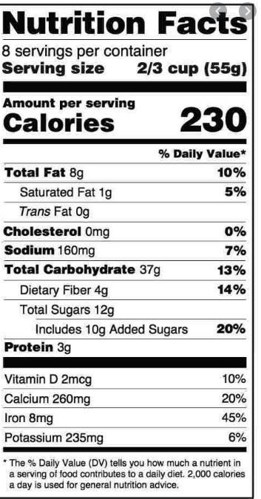

Slide 6
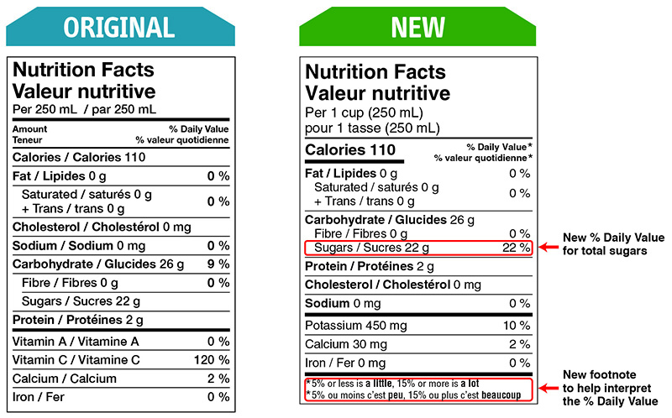

Slide 7
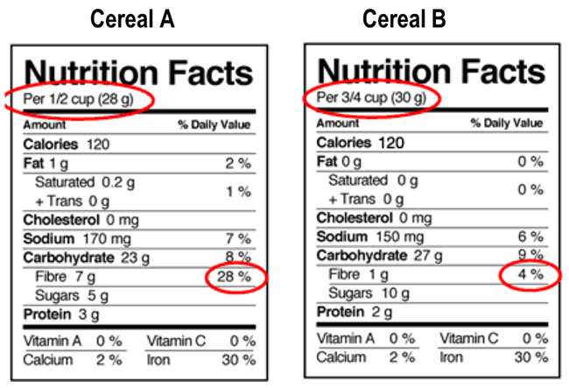

Slide 8
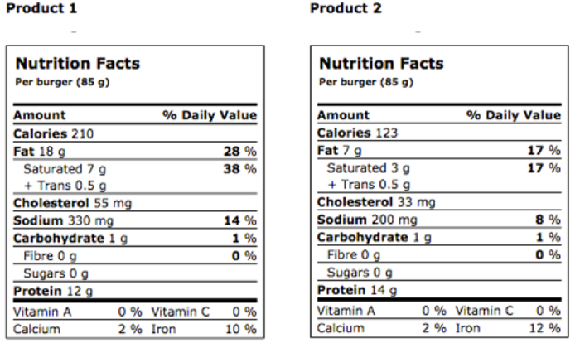

Slide 9
Ingredient list
1. All the ingredients in a packaged food.
2. In order of weight.
3. Check if a food product has a certain ingredient: added sugar.
4. Avoid ingredients in case of a food allergy or intolerance.

Slide 10
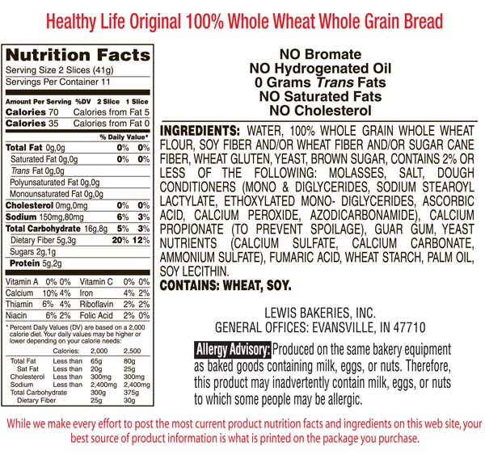

Slide 11
Happy Exerciese

Slide 12
Nutrition Claims
1.Nutrient content claims: amount of a nutrient in a food.
a good source of Ca
2. Health claims: helpful effects of a certain food .
help preventing osteoporosis
3. Optional:

